Slide 1
Database Management System Lab
IICT Library Management System
Team Members:
Ariful Islam Shanto – 2019831029
Hamim Rahman – 2019831034
Bijon Saha – 2019831007
Course Instructor:
Dr. Ahsan Habib
Assistant Professor
IICT, SUST

Slide 2
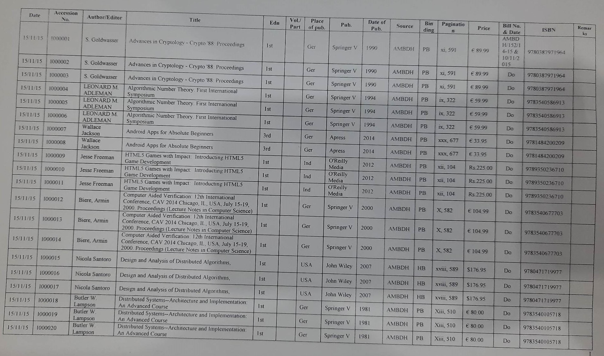
BOOK LIST

Slide 3
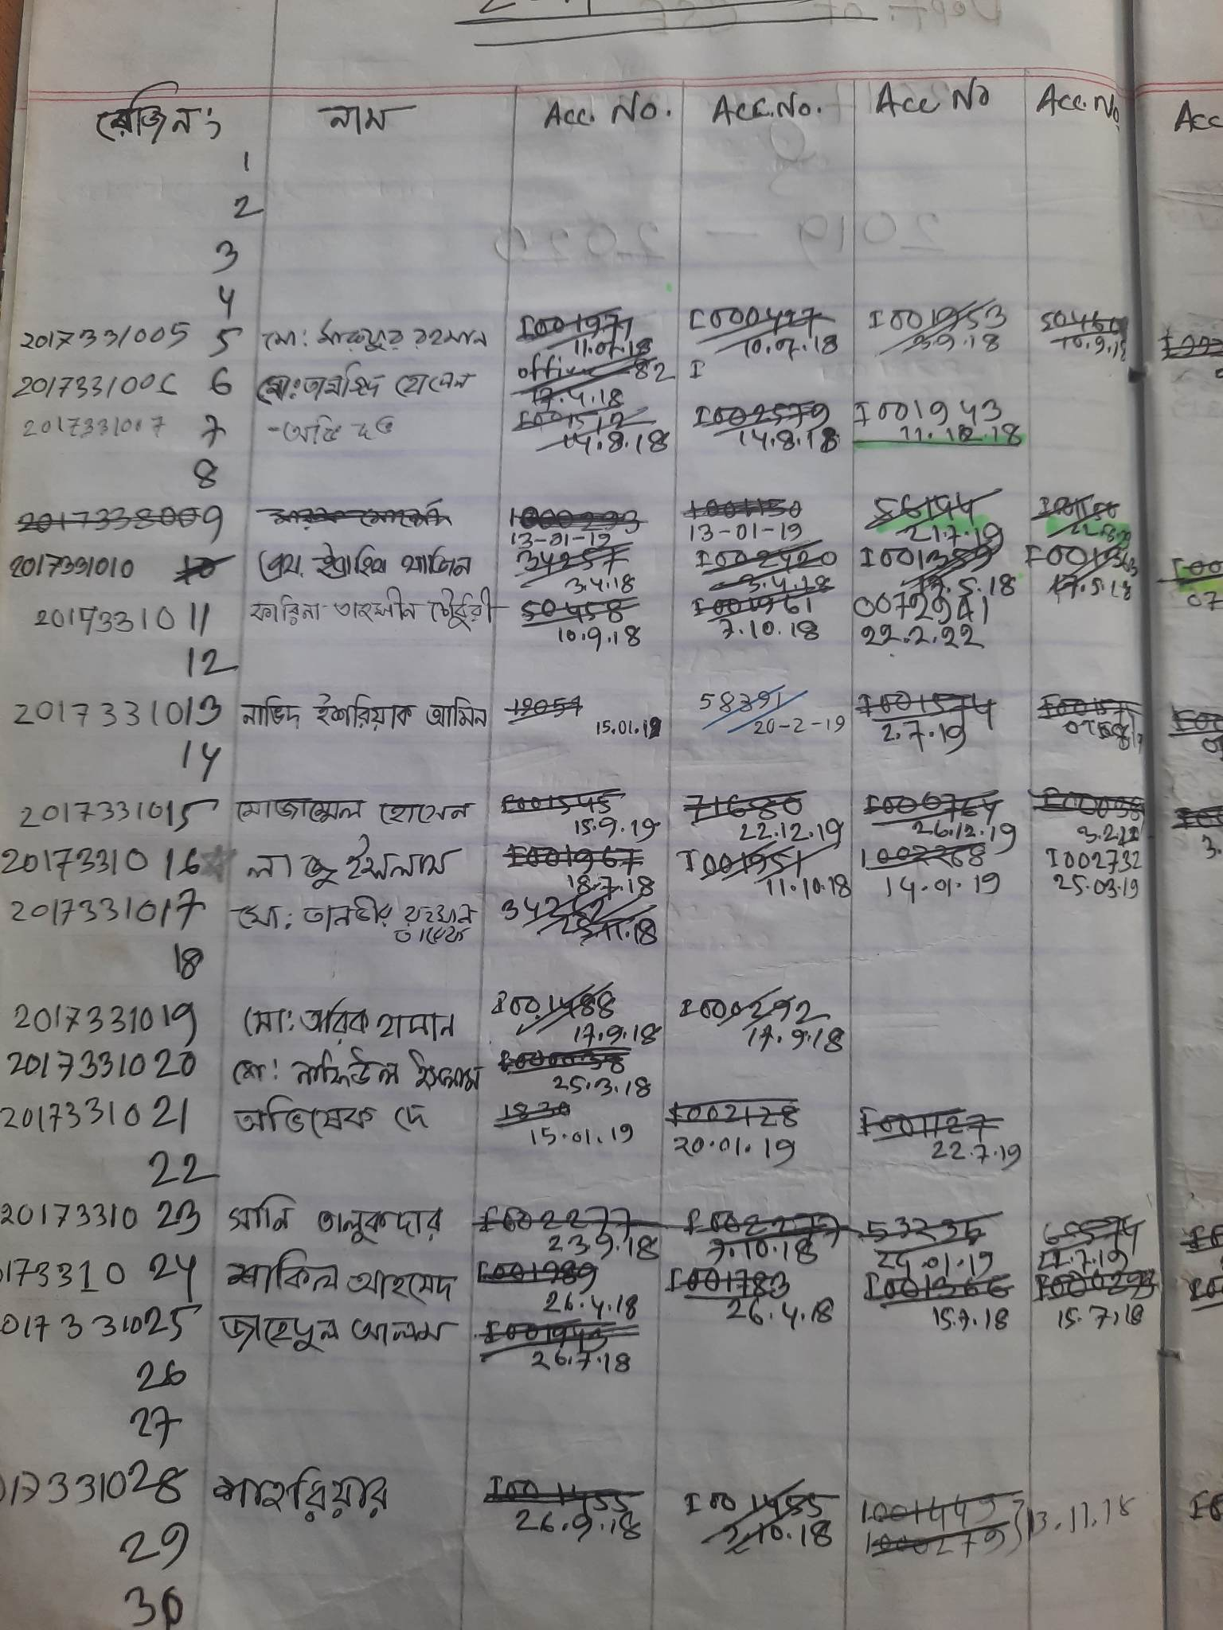
BOOK ISSUE AND RETURN

Slide 5
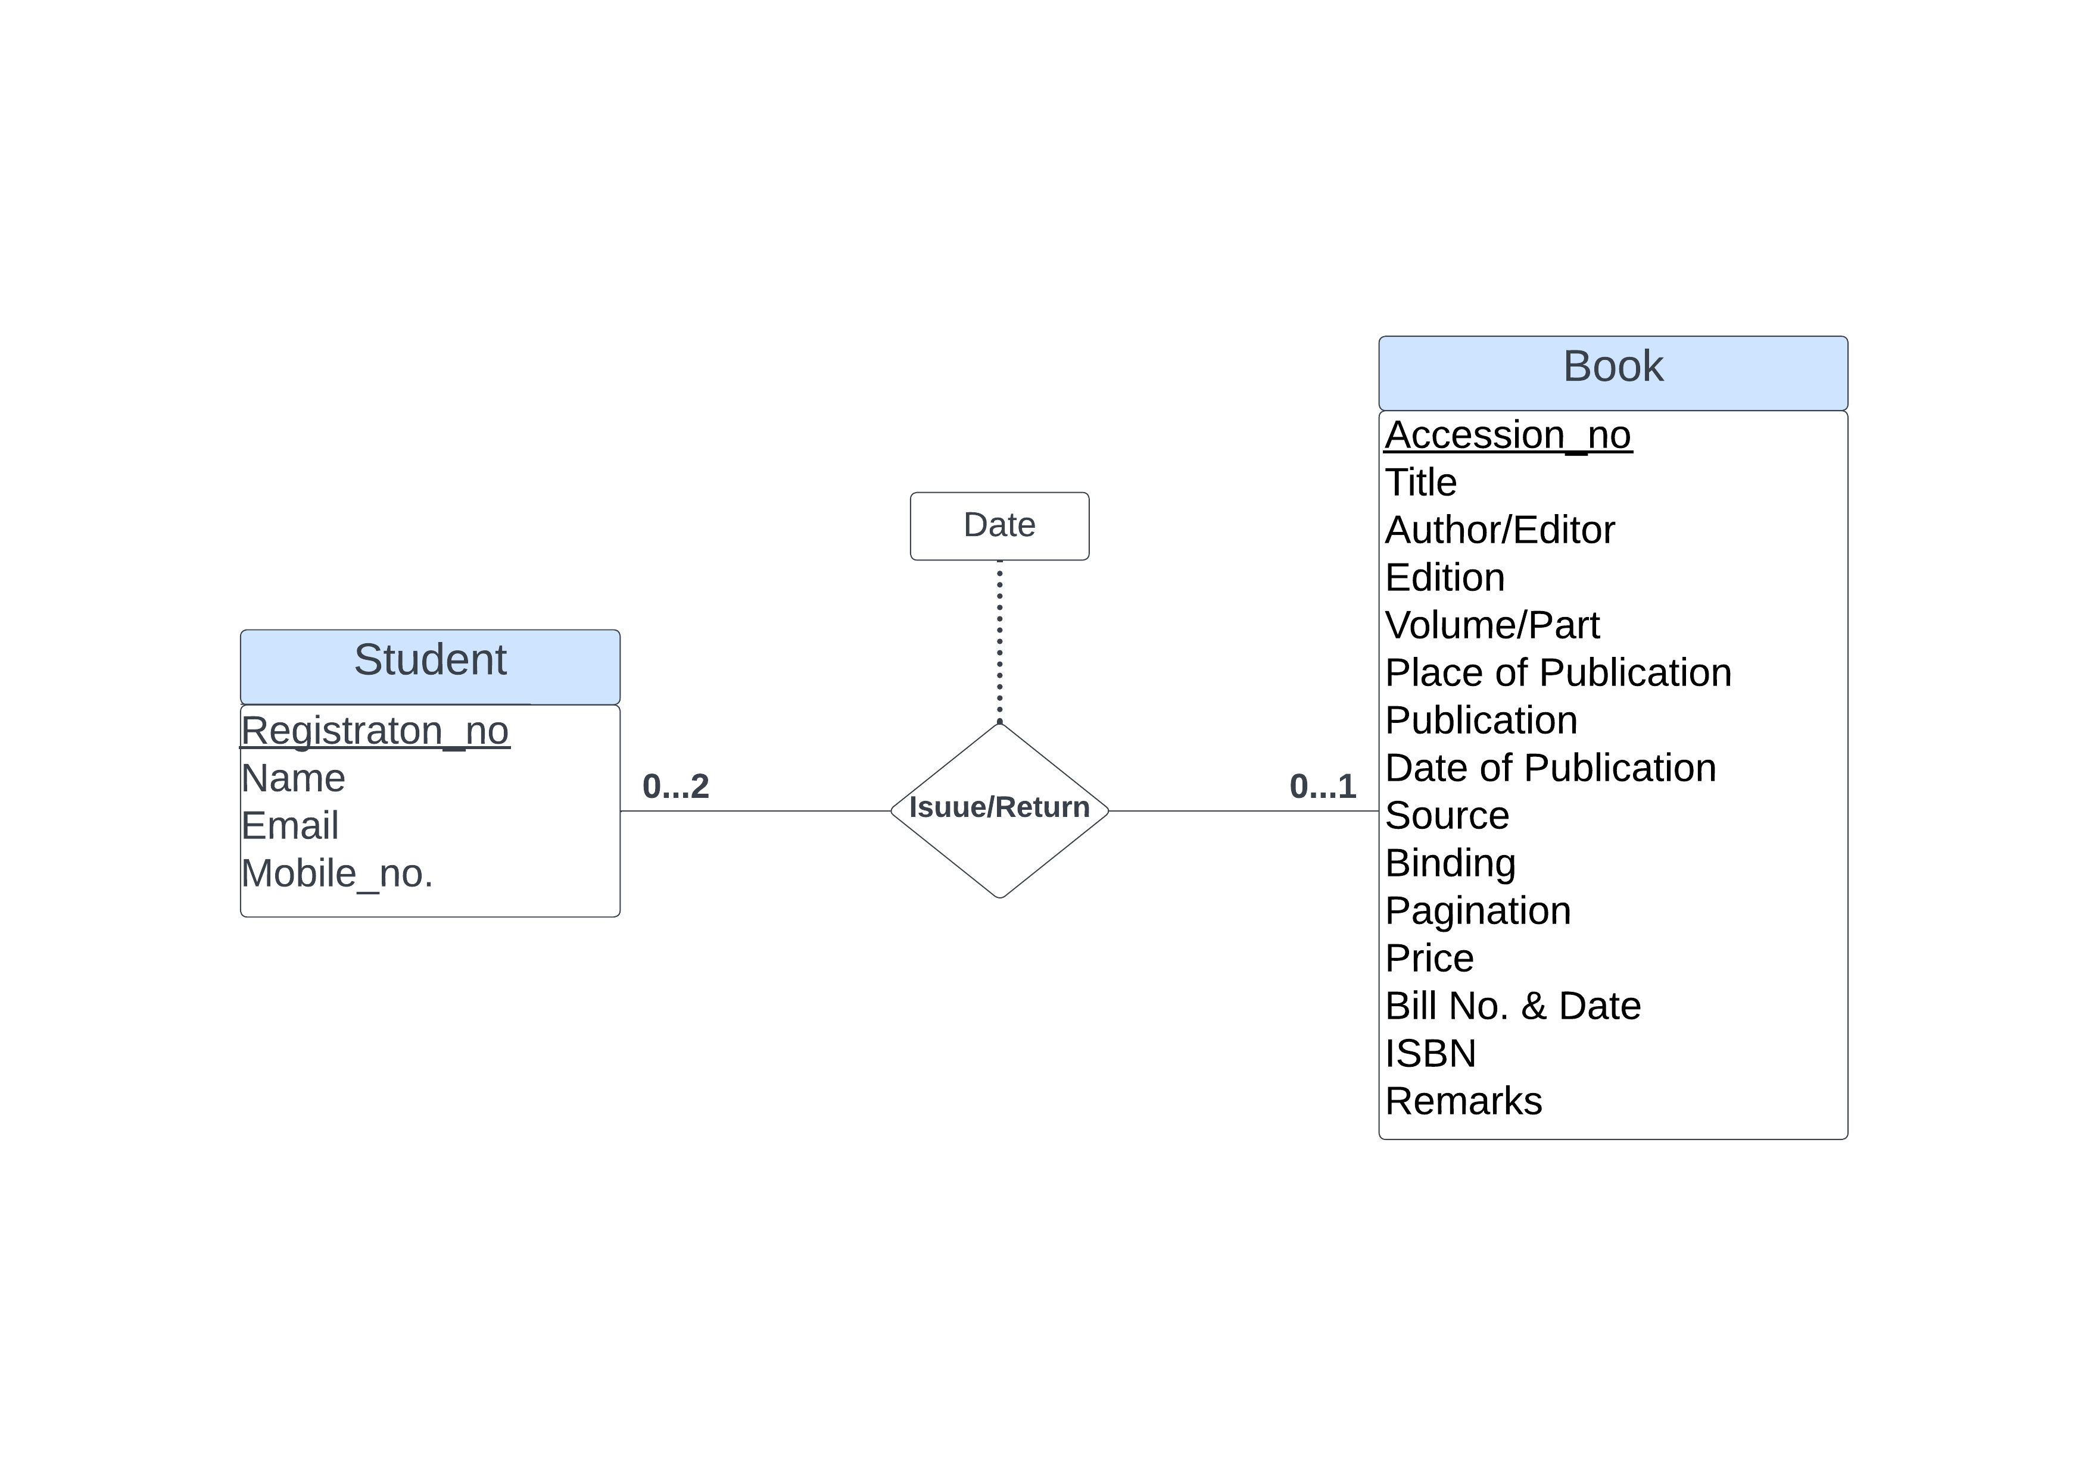
ER Diagram

Slide 6
Thank You

